Slide 1

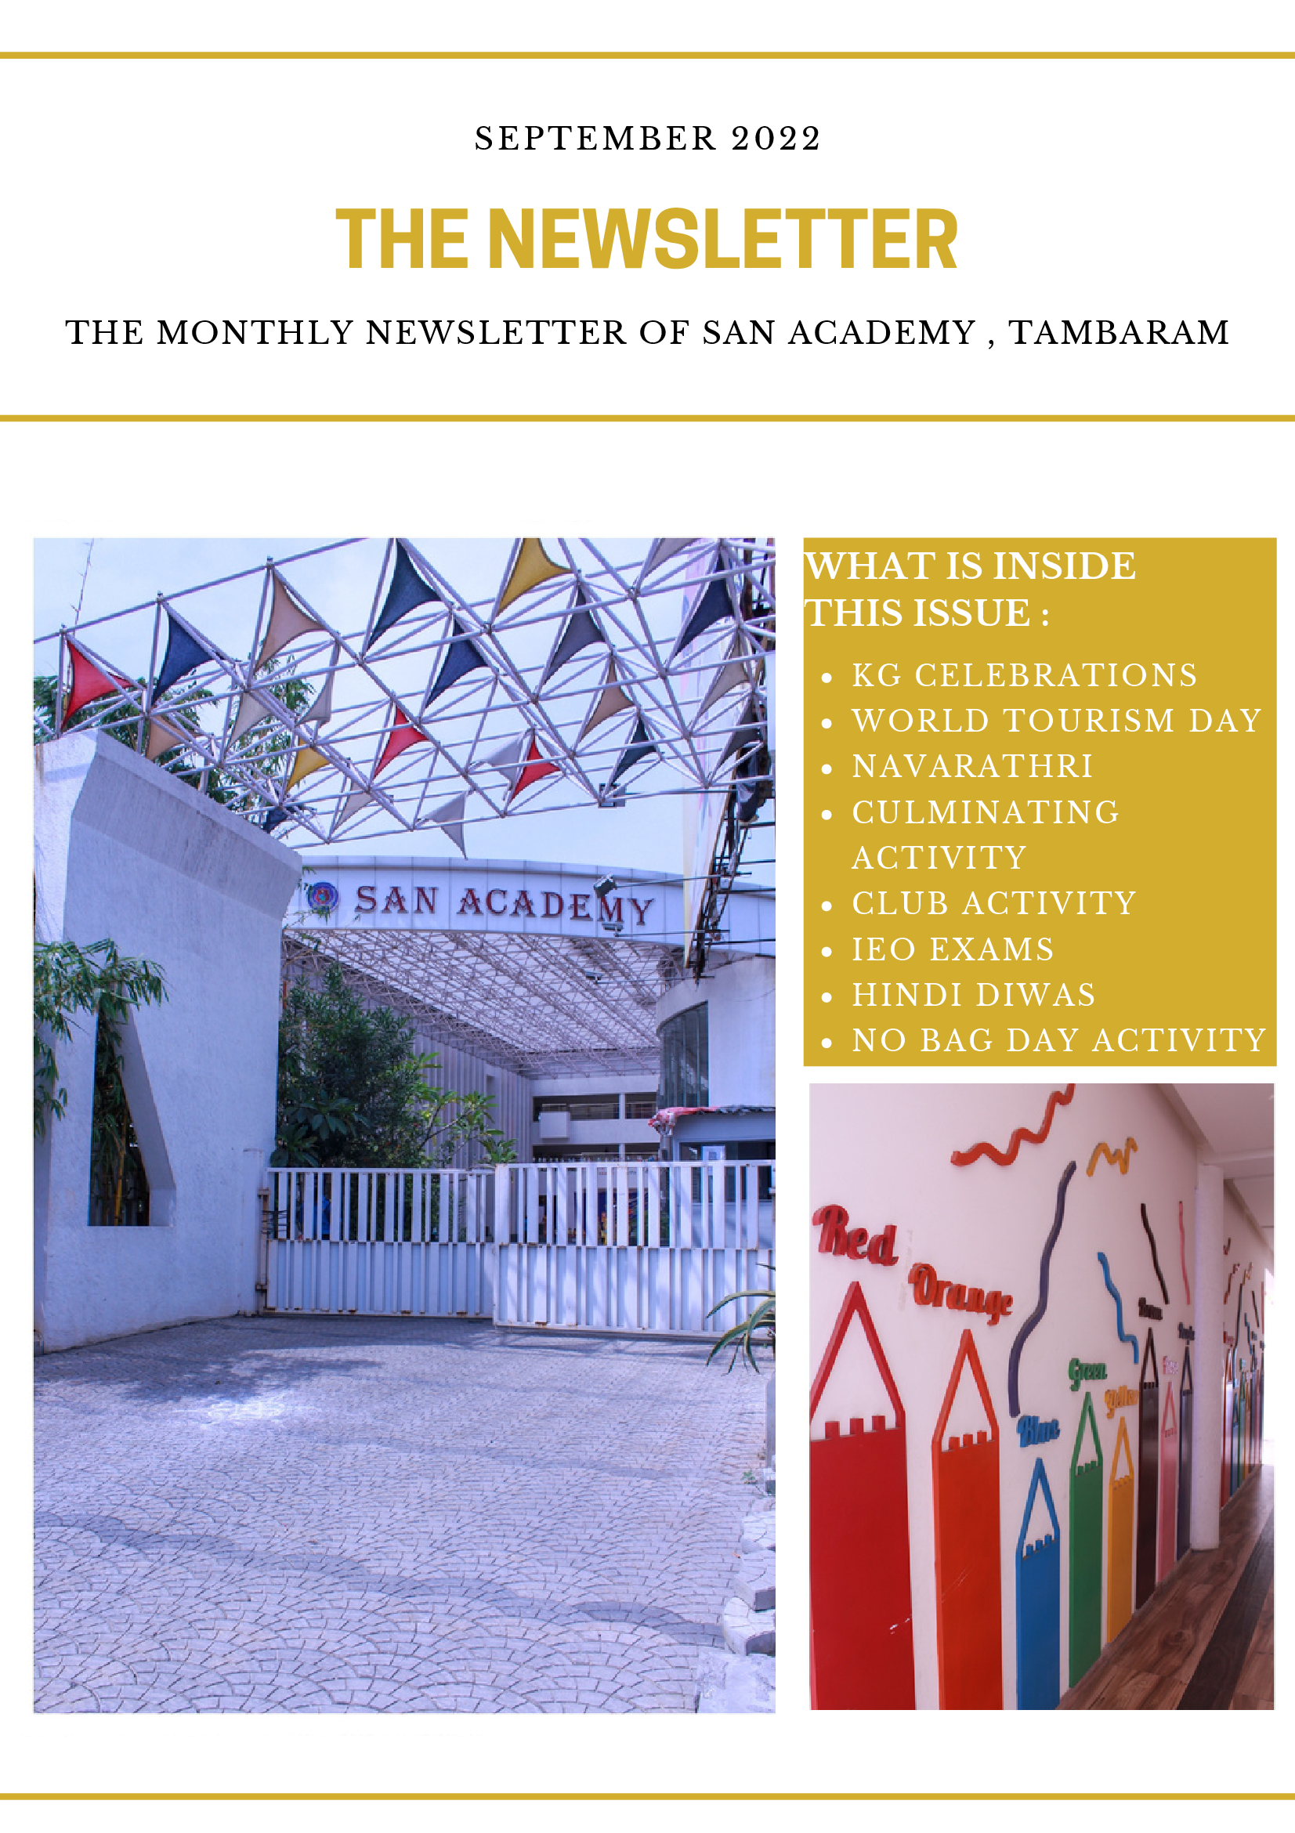
NOVEMBER 2022
THE NEWSLETTER
THE MONTHLY NEWSLETTER OF SAN ACADEMY,TAMBARAM
CONTENTS INSIDE THIS ISSUE
Nursery, JRKG, SRKG, Grade 1 – 4 ANNUAL DAY
Nursery, JRKG, SRKG – Intra School Competition
Nursery, JRKG, SRKG –Children’s Day Celebration
Nursery –Community Helpers Day
JRKG –Winged Wonders Day
SRKG –Aqua World Day
Nursery, JRKG, SRKG – Show & Tell
CLUB ACTIVITY
INTRA CLUB ACTIVITIES
NO TO PLASTIC DAY
NO BAG DAY
TELEVISION DAY
WORLD KINDNESS DAY

Slide 2
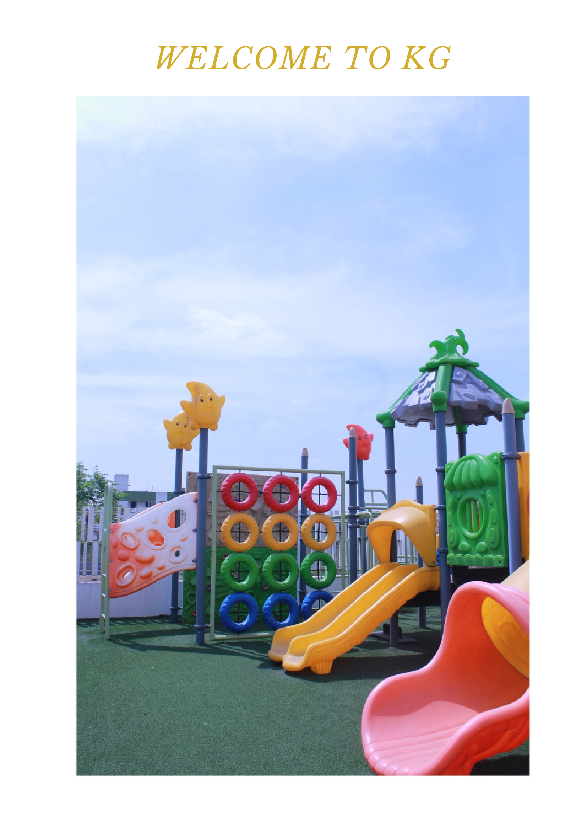
WELCOME TO KG

Slide 3
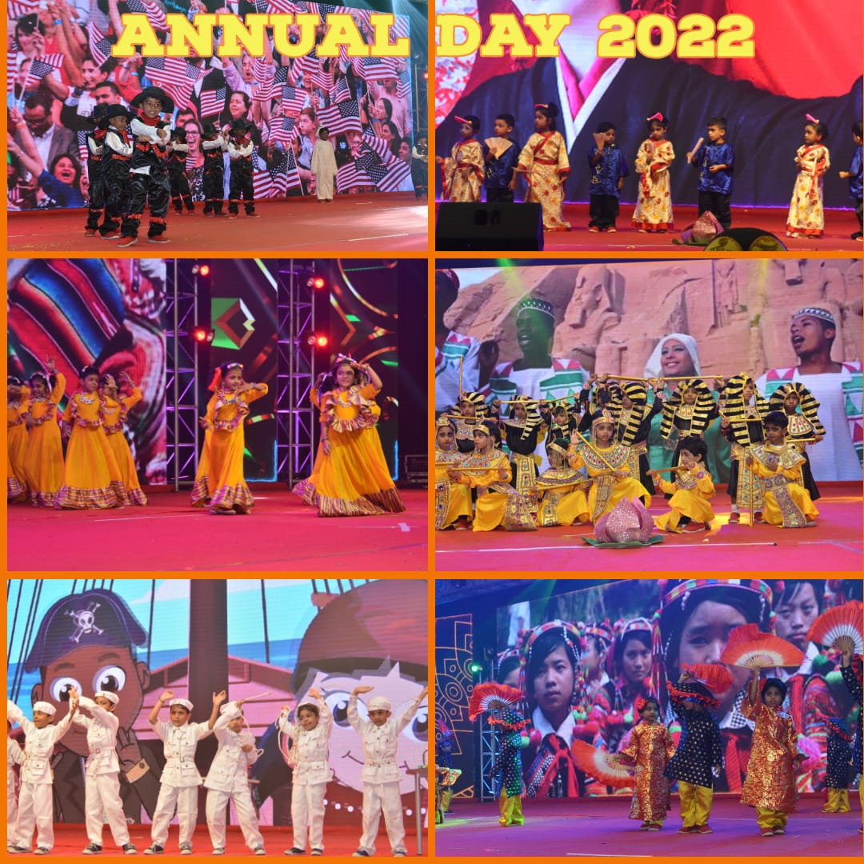
Nursery, JRKG, SRKG, Grade 1 – 4th ANNUAL DAY – 6.11.22
On November, 6th 2022, San Academy Tambaram celebrated its 4th Annual Day Fest in Jeppiar Engineering College Auditorium. The event was based on the theme Folklorama showcasing the cultural folk dances, folk music and folklores of various countries. Children were dressed in traditional costumes with beautiful properties based on each country’s theme and folk culture. The program commenced with Tamil Thai Vazthu followed by welcome dance, Principal’s address, Annual report, chief guest address, award ceremony and cultural events. Our chief guest for the event was Mr.Alkone Mimani – Director of Balaji Distribution Co, ltd. Children of Nursery, JrKG, SrKg and Grade 1 participated in various events including folk dances, folk songs and musical play. It was a memorable day for everyone.

Slide 4
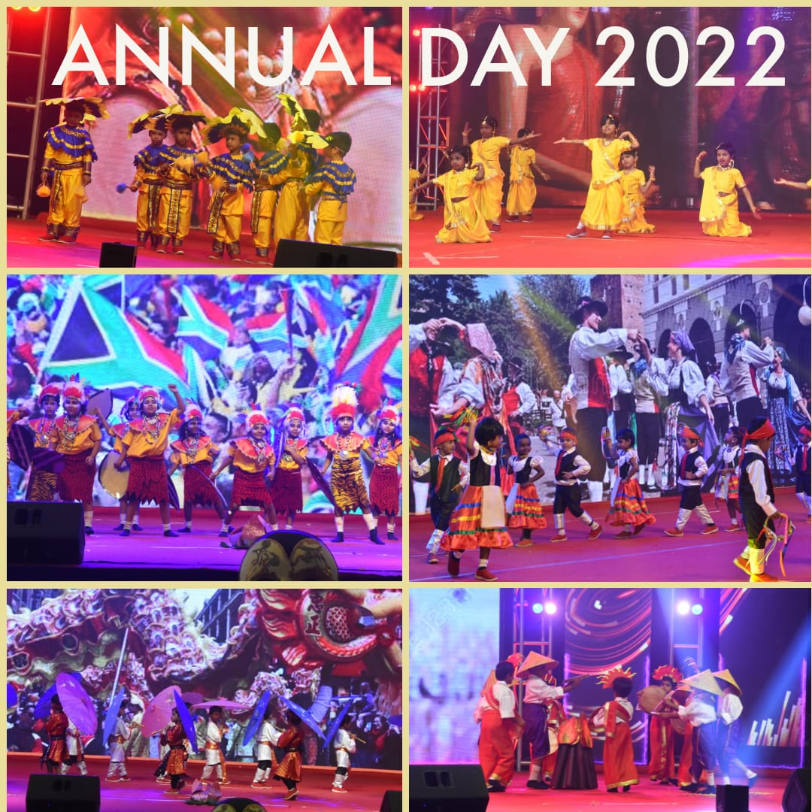
Nursery, JRKG, SRKG, Grade 1 – 4th ANNUAL DAY – 6.11.22

Slide 5
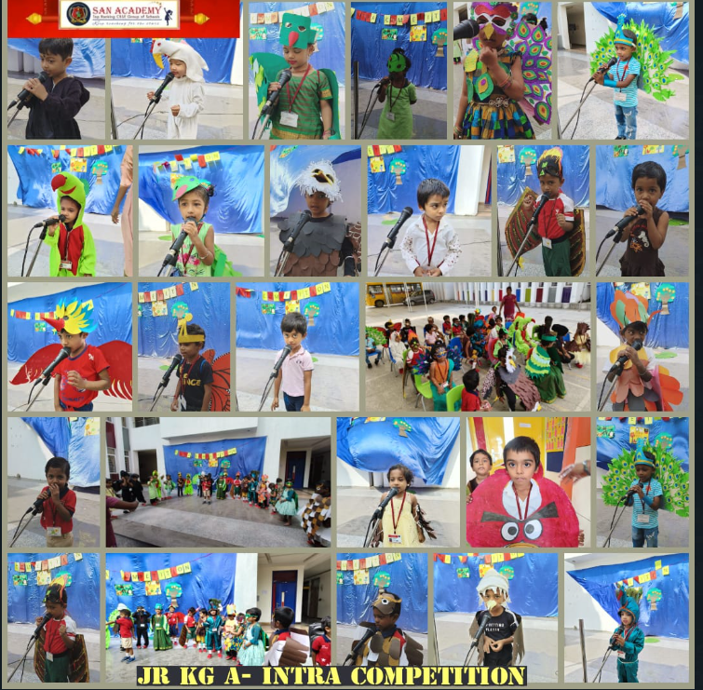
Nursery, JRKG, SRKG – Intra School Competition 9.11.22
On November, 9th 2022, children of Nursery, JrKG & SrKG participated in the Intra School Competition based on the topic Rhymes Recitation, Fancy Dress and Sing a Story. Children performed with innovative and colorful props according to the given theme. Nursery children performed with confidence and great enthusiasm. They all sang rhythmically with actions. Children of JrKG were dressed in vibrant colours with wings and head gears according to the theme Aerial Beings. SrKG children sang the story rhythmically. This event helped the children to boost confidence, to improve their memory and social skills. Children enjoyed the competition. Certificates and medals were awarded to the winners on the Children’s Day.

Slide 6
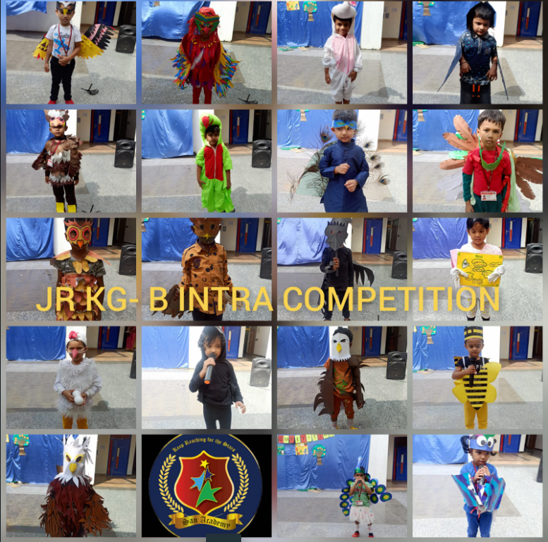
Nursery, JRKG, SRKG – Intra School Competition 9.11.22

Slide 7
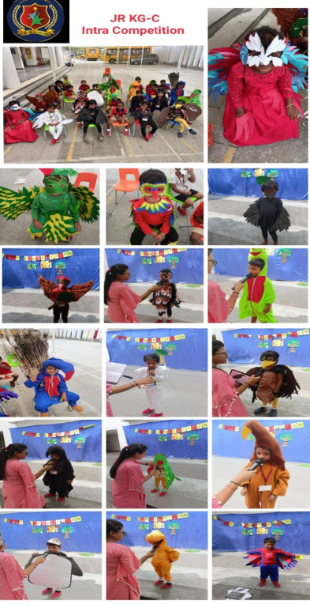
Nursery, JRKG, SRKG Intra School Competition 9.11.22

Slide 8
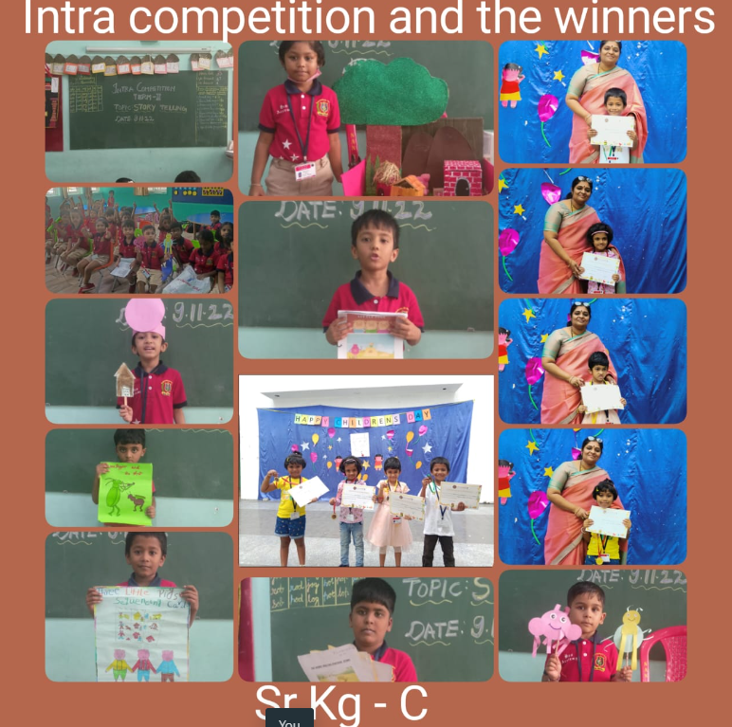
Nursery, JRKG, SRKG – Intra School Competition 9.11.22

Slide 9
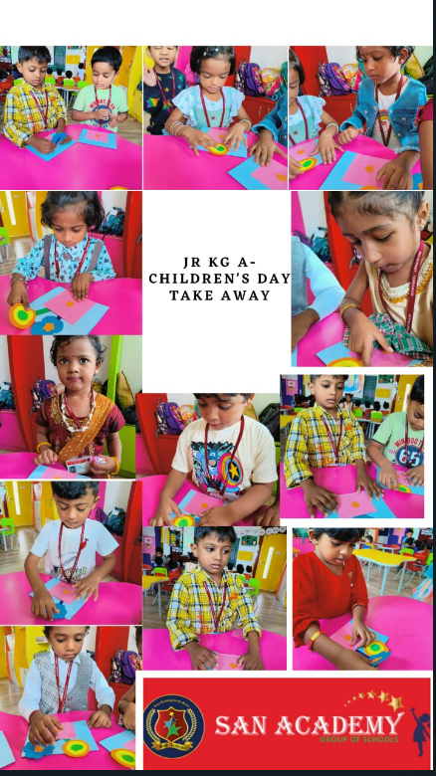
Nursery, JRKG, SRKG – Children’s Day Celebration– 14.11.22
On November 14th, 2022 children of Nursery, JrKG & SrKG celebrated the Children’s day. Teacher gave an introduction about children’s day. Children were all dressed in colourful attire. The celebrations began with Children’s day introduction followed by teacher’s dance performance and children’s dance performance. They had variety of fun filled activities and super hero photo booth planned for the day. Children enjoyed an animated movie in their classroom. Later they made a paper rose for the take home activity.

Slide 10
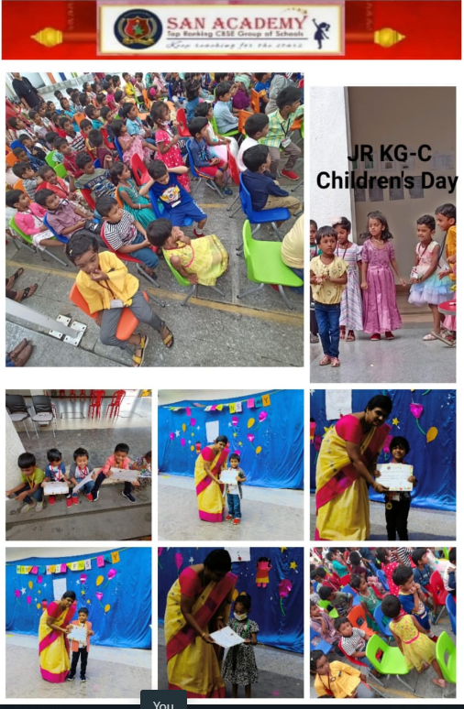
Nursery, JRKG, SRKG – Children’s Day Celebration– 14.11.22

Slide 11
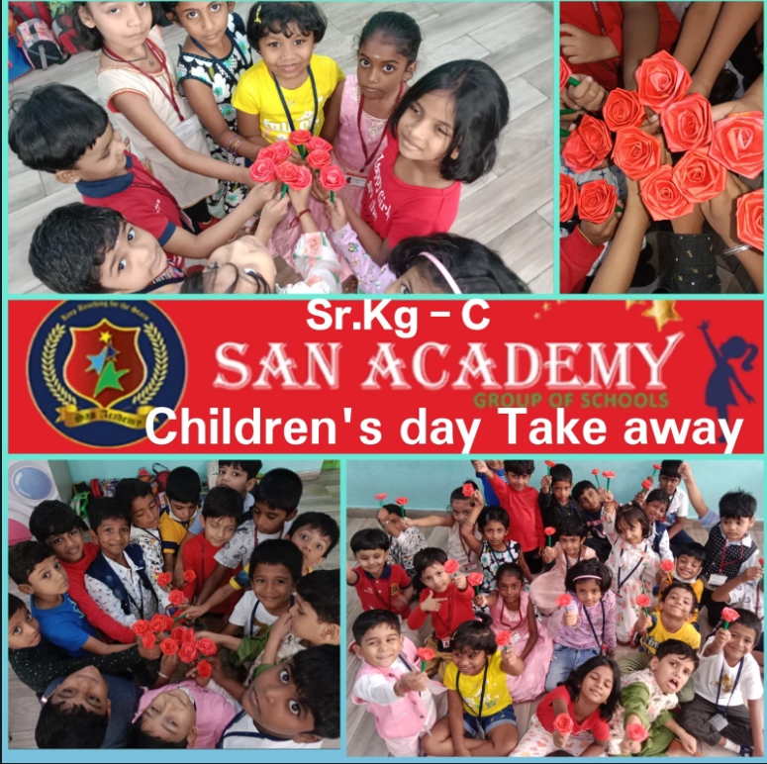
Nursery, JRKG, SRKG – Children’s Day Celebration– 14.11.22

Slide 12
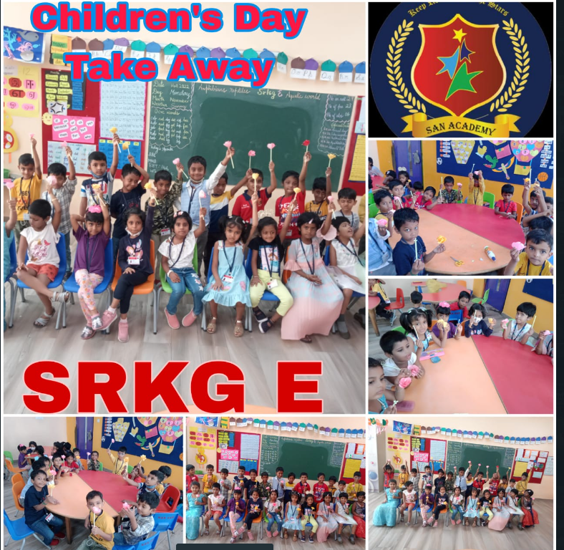
Nursery, JRKG, SRKG – Children’s Day Celebration– 14.11.22

Slide 13
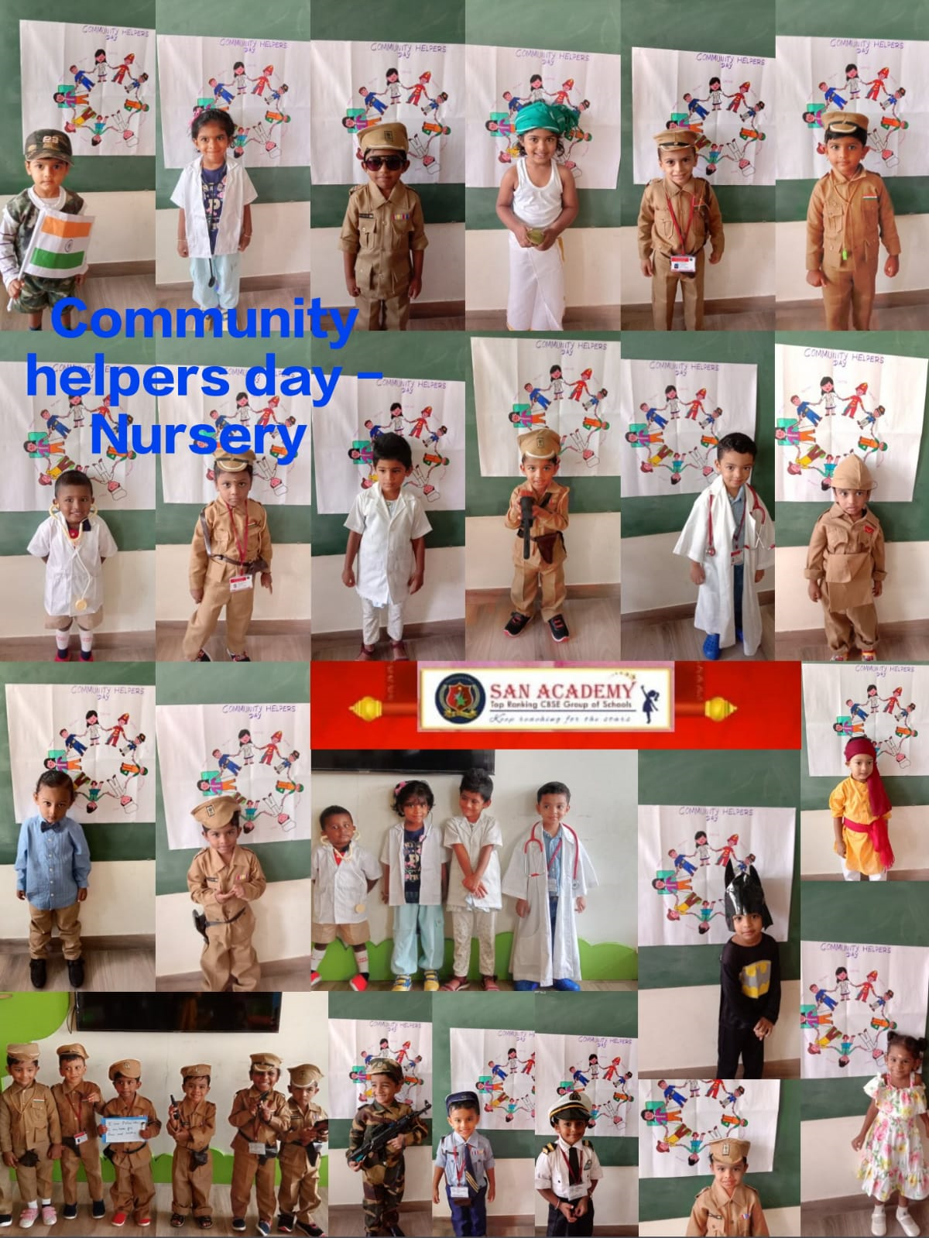
Nursery –Community Helpers Day 15.11.22
On November 15th, 2022 children of Nursery celebrated the Community helper’s day. Teacher taught them about the community helpers and their workplace. Children dressed up like various community helpers such as doctor, nurse, fire fighter, teacher, farmer, engineer and milkman. Children introduced themselves with the tools and things used by them. They all enjoyed making the baker’s craft.

Slide 14
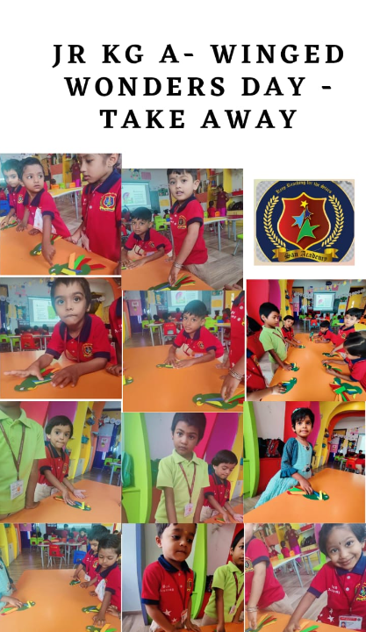
JRKG –Winged Wonders Day
On November 15th, 2022 children of JrKG celebrated Winged Wonders day. This event was organised to make the children learn about different type of birds. Children walked the ramp dressed like birds. Learning about birds developed compassion towards various types of birds and their importance Children performed an action bird dance. They enjoyed the special day and made beautiful parakeet crafts. This enhanced creativity and fine motor skills

Slide 15
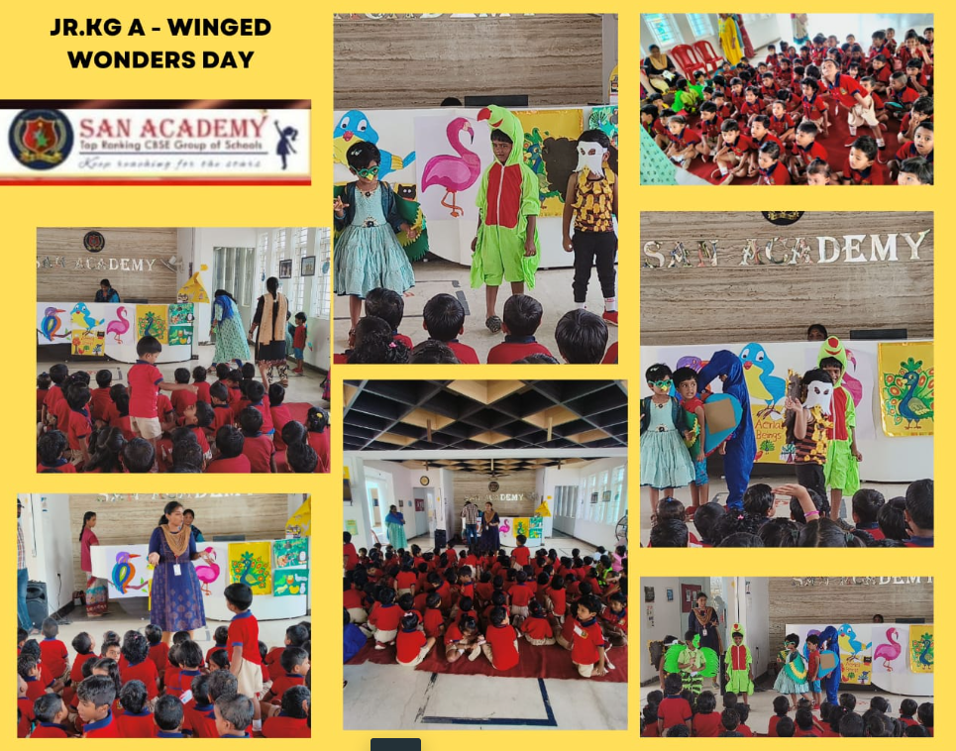
JRKG –Winged Wonders Day

Slide 16
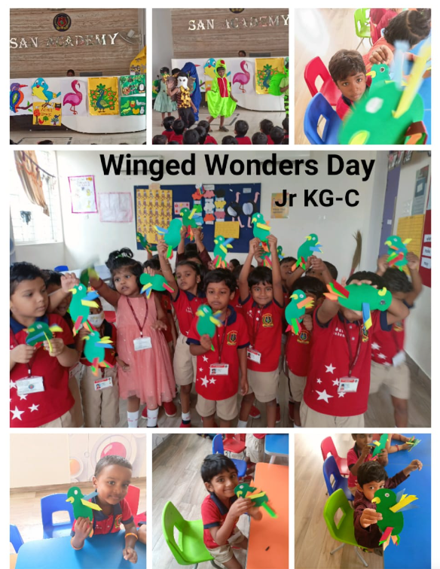
JRKG –Winged Wonders Day

Slide 17
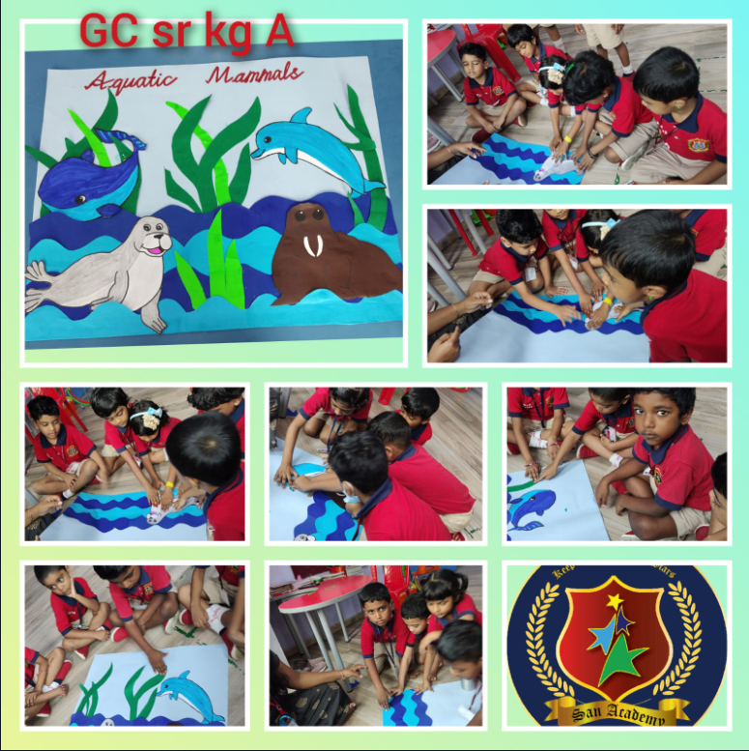
SRKG –Aqua World Day
On November 16th, 2022 children of Sr.KG had a special event Aqua World Day. Teacher taught the children about the importance of water and the aquatic creatures. Children were taught about the endangered aquatic animals and how it can be protected. Teacher also explained them how to save water starting from home. Children danced together and enjoyed enacting like water animals by wearing head gears of different aquatic animals.

Slide 18
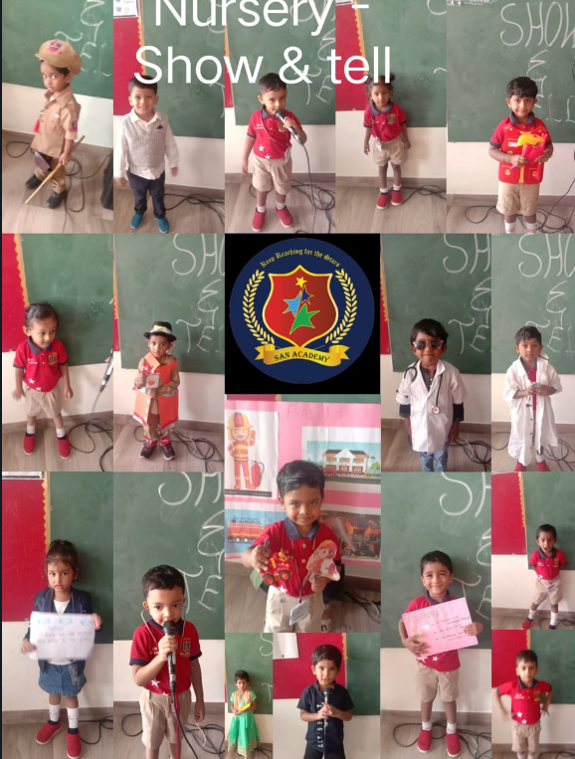
Nursery – Show & Tell – 21.11.22
Children of Nursery participated in Show and Tell event. Children dressed up in theme based costumes and performed with confidence and great enthusiasm. They also presented the show and tell with the props and placards based on the given topic community helpers. This event motivated the children to express their ideas and thoughts in a creative way.

Slide 19
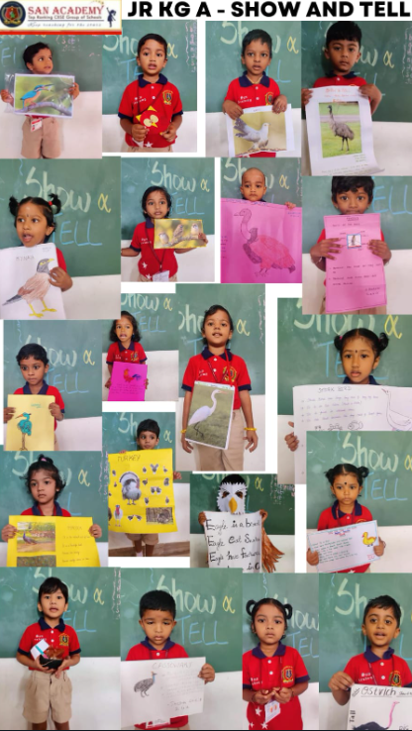
JRKG – Show & Tell – 22.11.22
Children of JrKG participated in the Show and Tell event and performed confidently speaking about their favourite bird. They looked adorable in colourful costumes and make up with handmade props. Their excitement to perform was sky rocketing. They shared their knowledge about bird’s parts and its different features. This activity helped them to build confidence and self-esteem. It also enabled them to describe an object by communicating feelings, thoughts and emotions with words. It was an interesting and a thrilling experience for the students sharing their thoughts and views with peers. This gave them a comfortable learning arena for everyone involved.

Slide 20
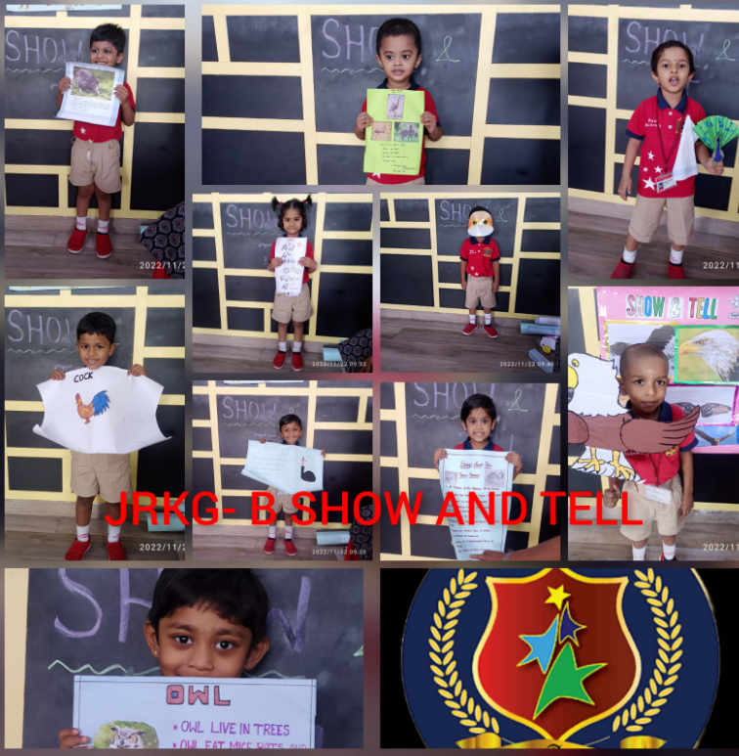
JRKG – Show & Tell – 22.11.22

Slide 21
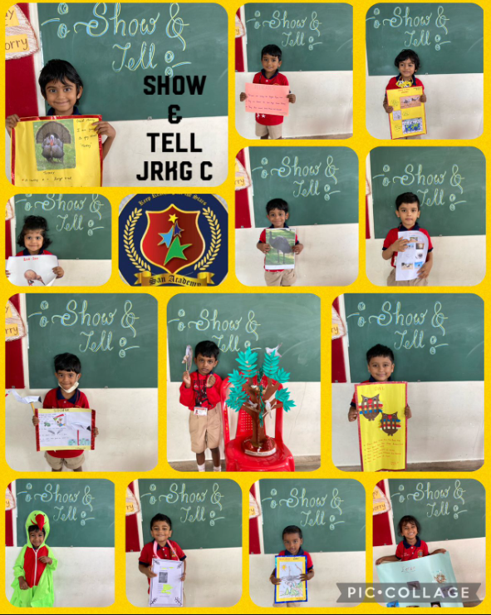
JRKG – Show & Tell – 22.11.22

Slide 22
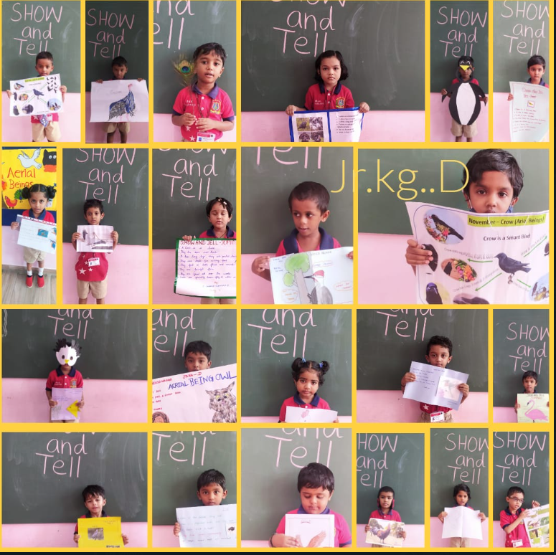
JRKG – Show & Tell – 22.11.22

Slide 23
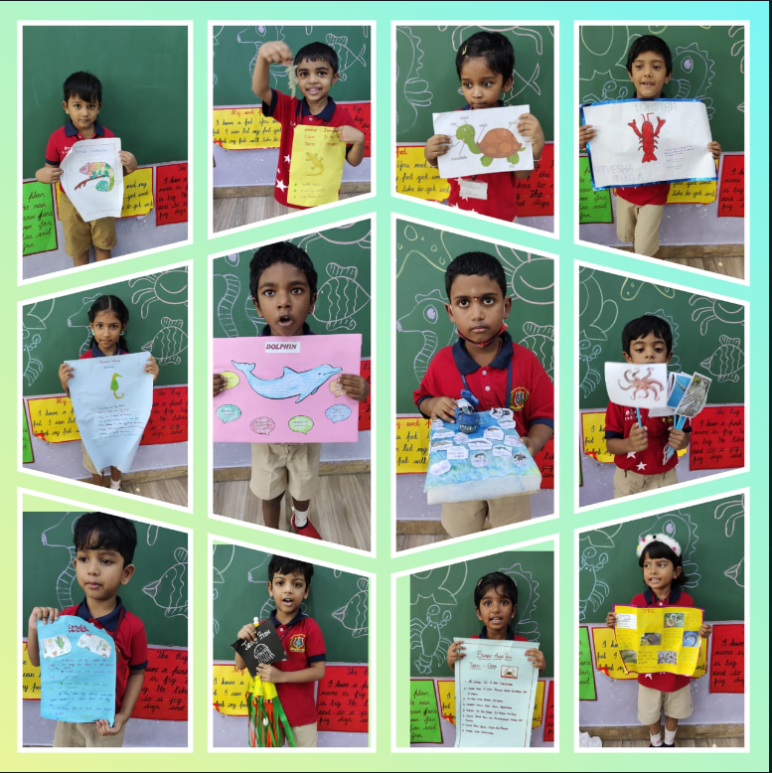
SRKG – Show & Tell – 23.11.22
Children of Sr.KG participated in the Show and Tell event. Children showcased their talent by performing the given topics Aquatic World, Amphibians and Reptiles. Children chose a topic and they talked about it. It gave a good platform for children to exhibit their learning based on the theme. This event improved the communication skills of the children. Children came out with creative props to explain the topics. They spoke with great confidence.

Slide 24
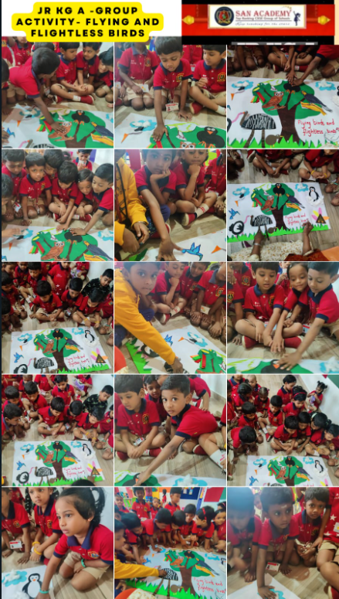
CLUB ACTIVITY

Slide 25
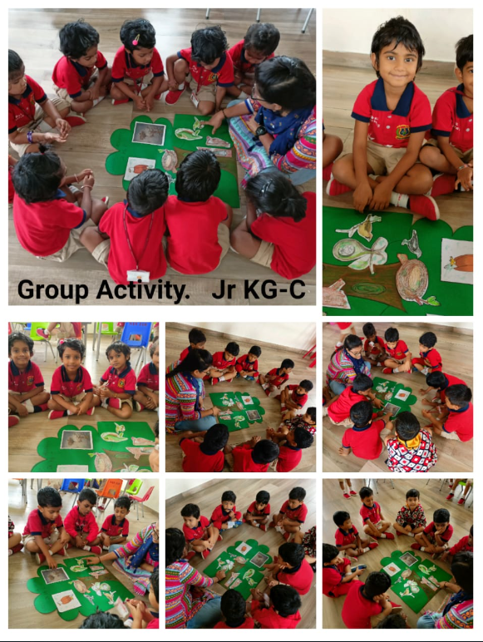
CLUB ACTIVITY

Slide 26
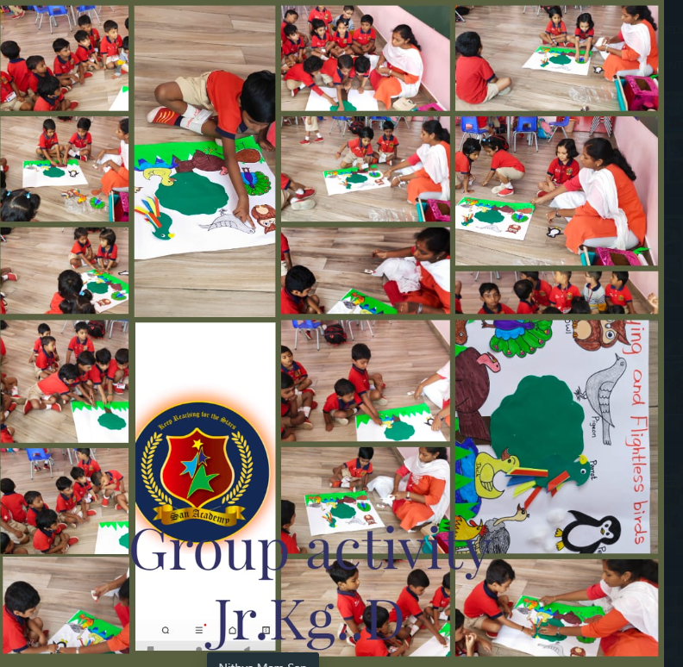
CLUB ACTIVITY

Slide 27
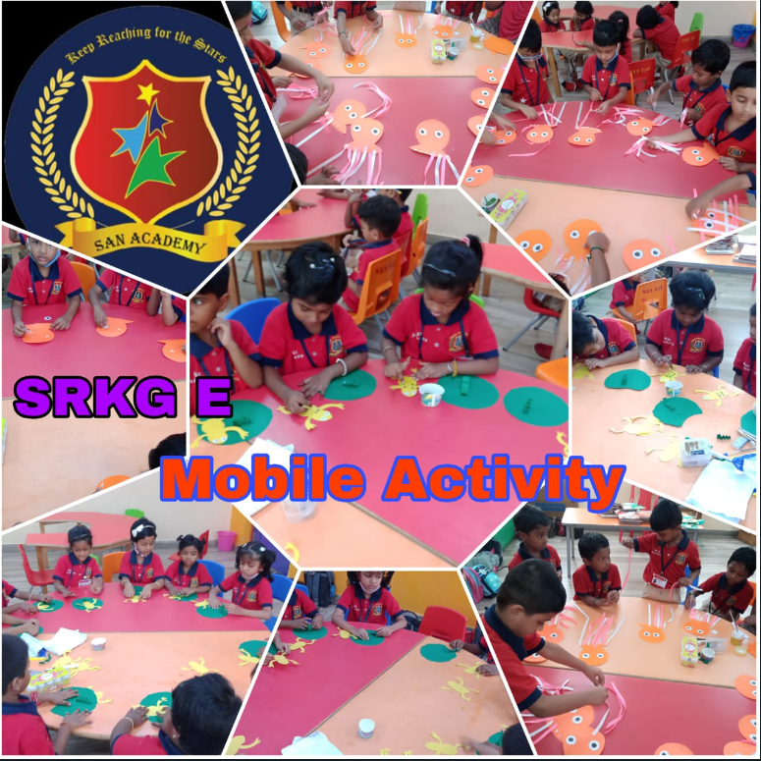
CLUB ACTIVITY

Slide 28
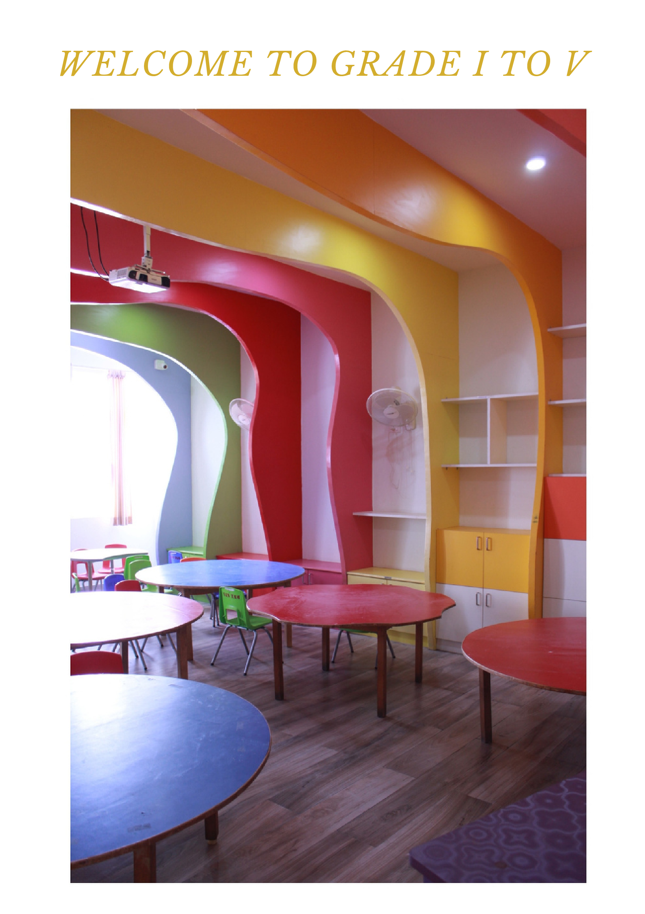
WELCOME TO GRADE I TO V

Slide 29
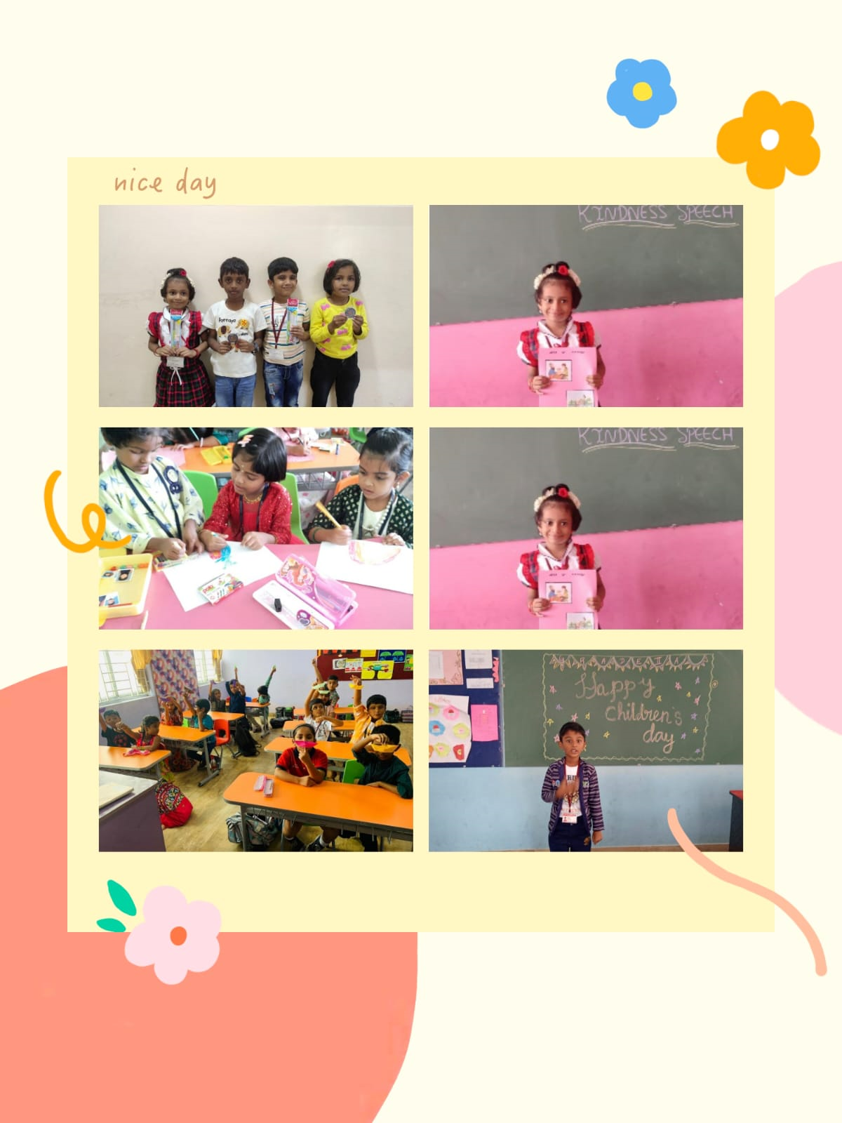
Children’s day GRADE I & II – 14.11.22
“Every child is a different kind of flower and all together they make this world a beautiful garden”. Children’s day is one of the most important and memorable day is a student life. To make the day more special and to bring out the talents of children, various competitions were conducted for the students of Grade I & II. It includes Drawing,Origami, Speech on waste management, Importance of kindness. Winners were awarded with prizes and others were appreciated by the teachers for their efforts

Slide 30
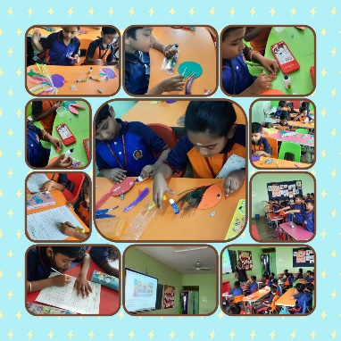
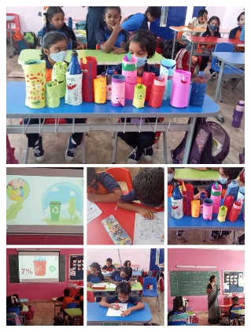
NO TO PLASTIC ACTIVITY – 18.11.22
At “SAN” we care for the environment. To create an awareness in students the benefits of avoiding usage of plastic, ‘NO TO PLASTIC” activity was conducted on 18.11.22. Students were shown ppt’s/videos on harmful effects of Plastic. They were also given inputs on how it can be reused worthfully. For better understanding activity like “Bird making” out of waste CD’s and Pencil stand making were given to children which were so creative and colourful.

Slide 31
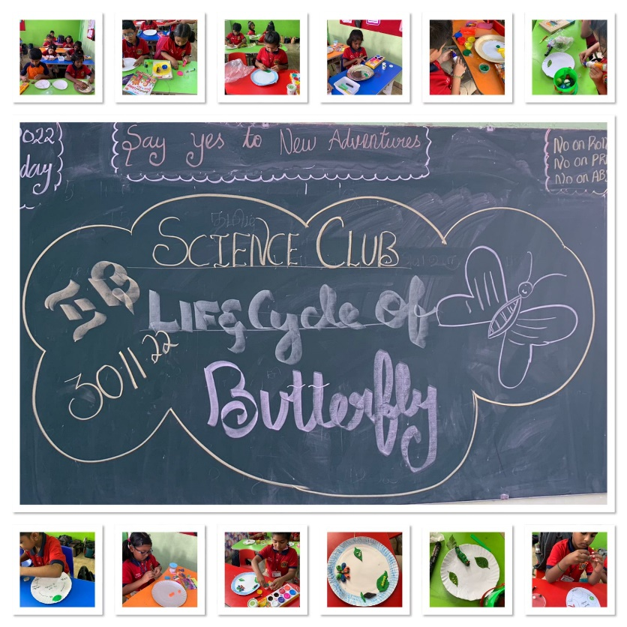
INTRA CLUB ACTIVITY (SCIENCE CLUB)
SCIENCE helps children develop key life skills , including an ability to communicate , remain organized and focused, and even from their own opinions based on observation .Science also helps children their senses and overall awareness. The main purpose of the CLUB is to help students generate solutions for everyday life as science is one of the most important channels of knowledge it helps to create awareness on societal needs and global changes to the students.
To experience this various intra club activities were conducted like introduction to world science day, drawing the life cycle of butterfly and creating it using clay modelling etc.

Slide 32
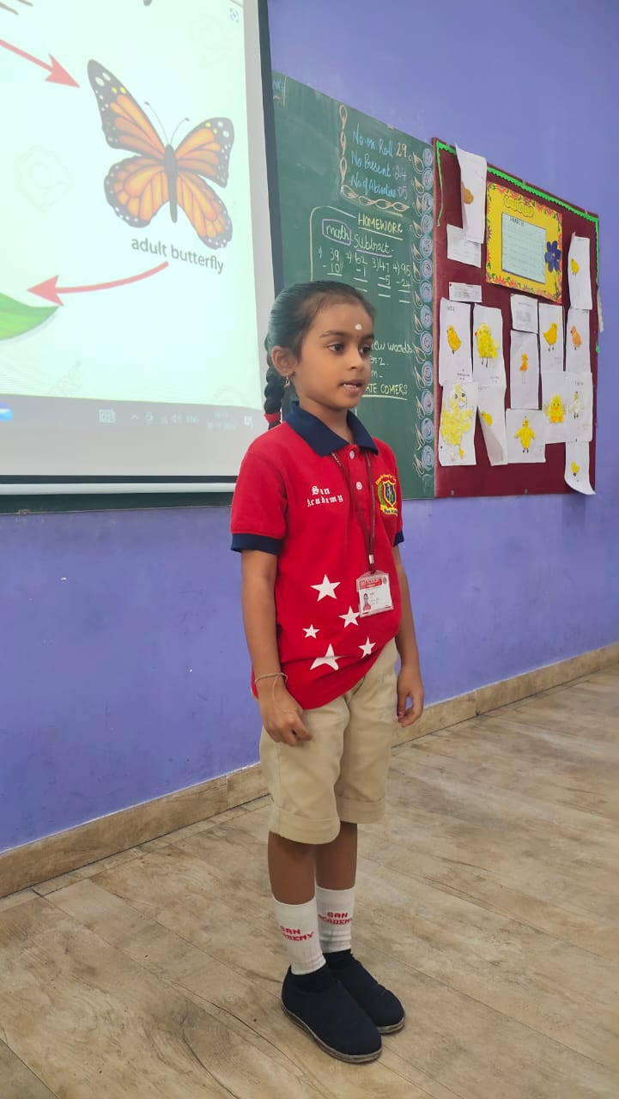
INTRA CLUB ACTIVITY (SCIENCE CLUB)

Slide 33
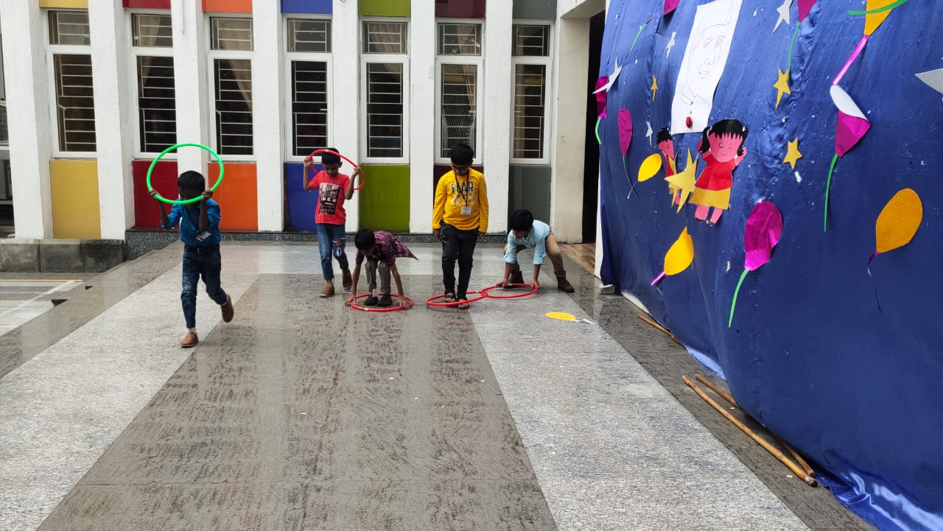
NO BAG DAY – 14.11.22
A “No Bag day” was conducted for the students of Grade I & II on 14.11.22. To make the children understand about playing outdoor and to create awareness on physical fitness, students were were given many “Outdoor games” to play. They played games like free running, jumping, fire in the mountain game, hurdle race etc. It was not only a new experience but also a fun-filled day for the students.

Slide 34
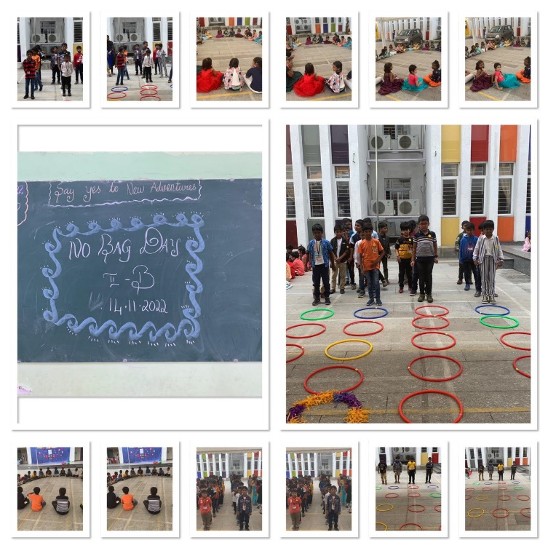
NO BAG DAY – 14.11.22

Slide 35
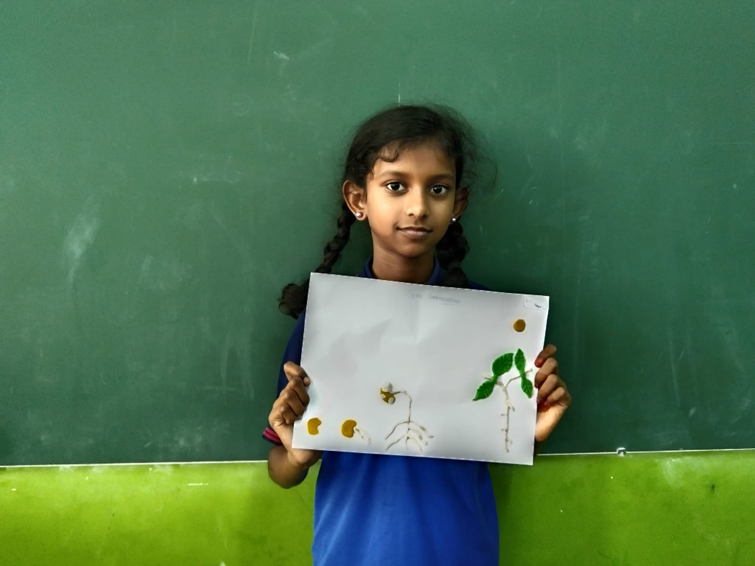
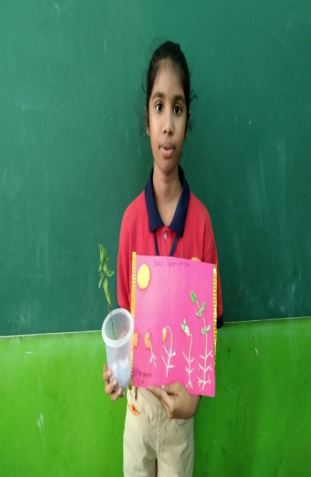
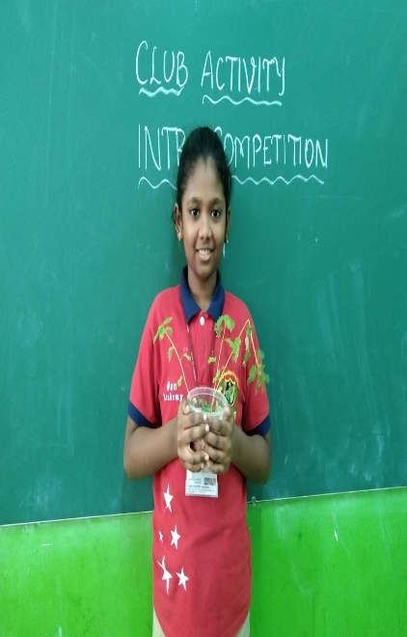
GRADE III TO V SCIENCE CLUB - 30.11.22
SCIENCE helps children to develop key life skills, including an ability to communicate, remain organized and focused, and even from their own opinions based on observation. Science also helps children their senses and overall awareness. SCIENCE is important for a variety of reasons including: The main purpose of the CLUB is to help students generate solutions for everyday life as science is one of the most important channels of knowledge it helps to create awareness on societal needs and global changes to the students.Students will get introduction to World science day for peace and development by witnessing the importance and relevance of science in our daily lives by seeing pictures. Also they will develop knowledge about the Life cycle of Plants.

Slide 36
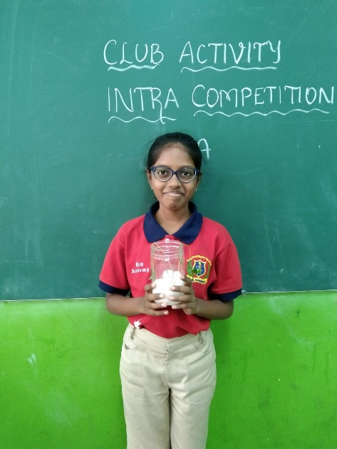
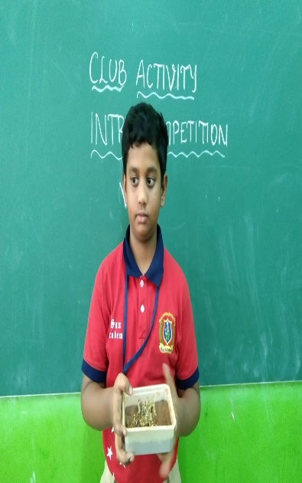
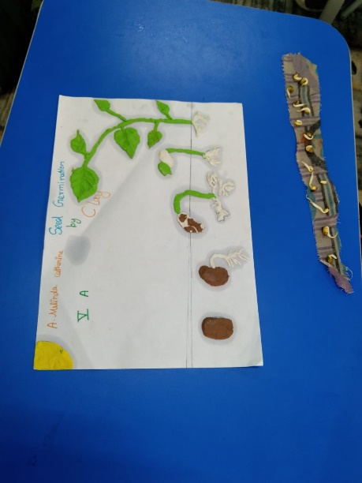
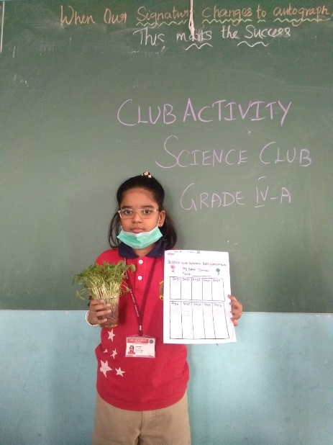
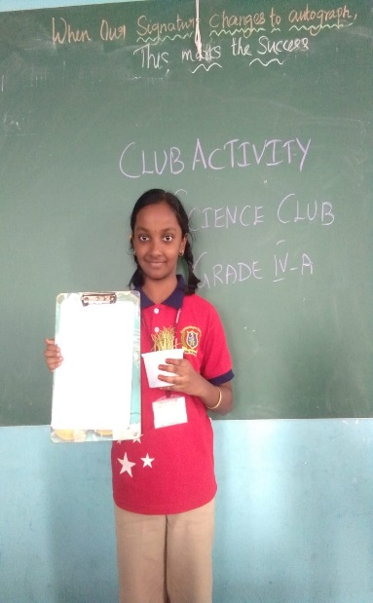
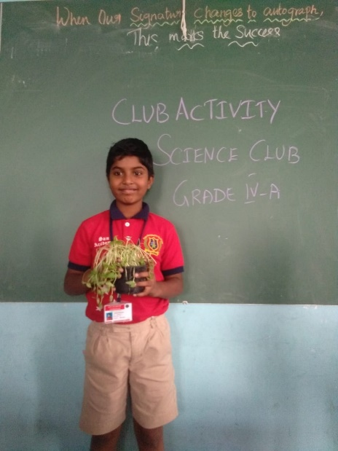
GRADE III TO V SCIENCE CLUB - 30.11.22

Slide 37
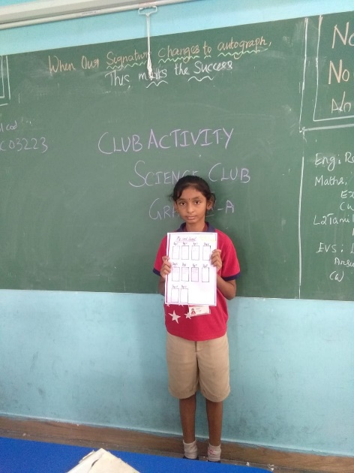
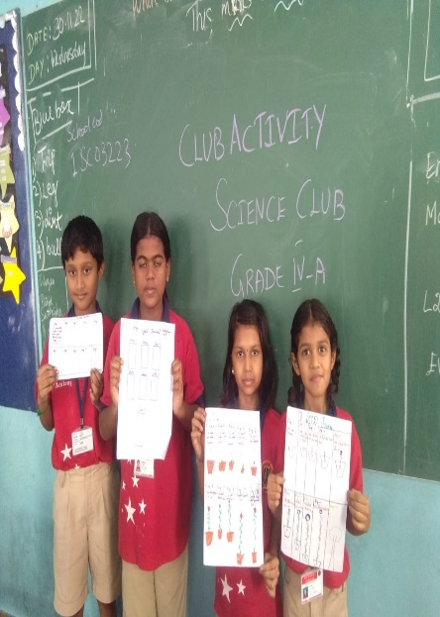
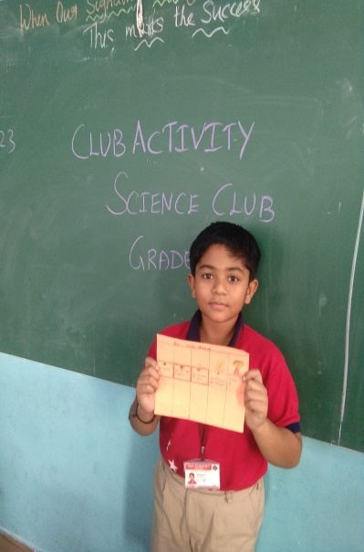
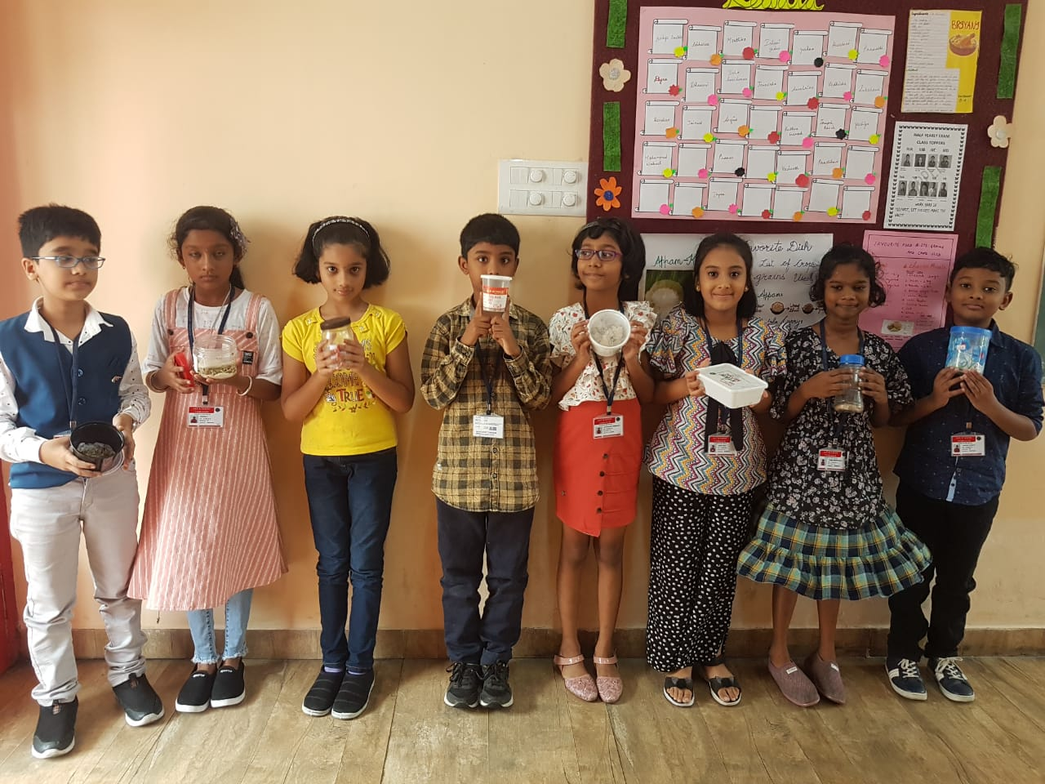
GRADE III TO V SCIENCE CLUB - 30.11.22

Slide 38
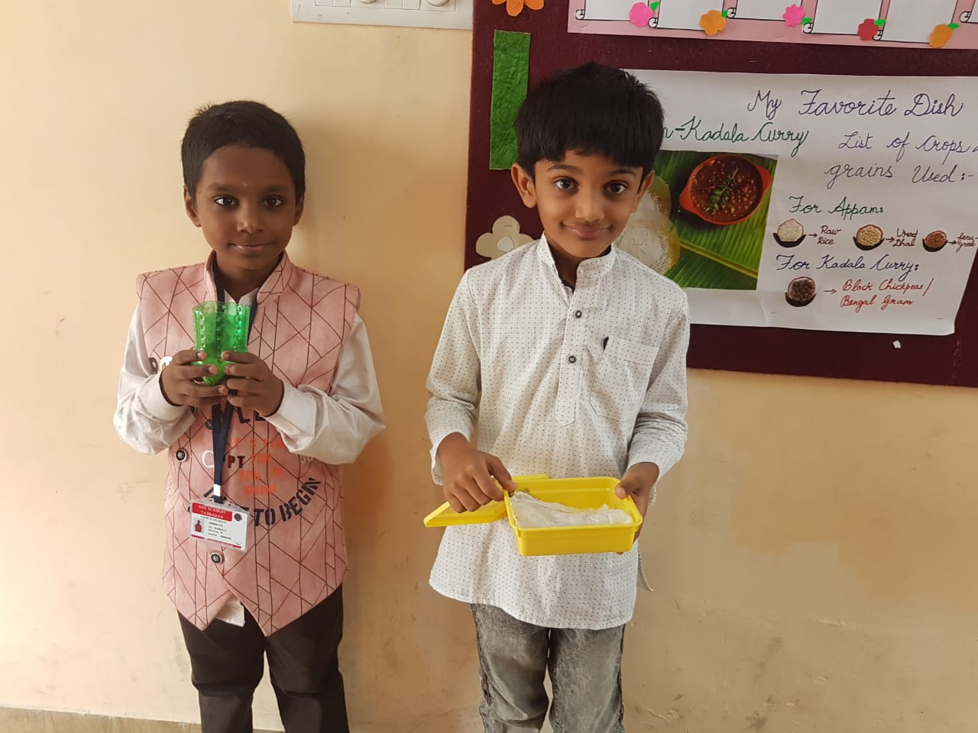
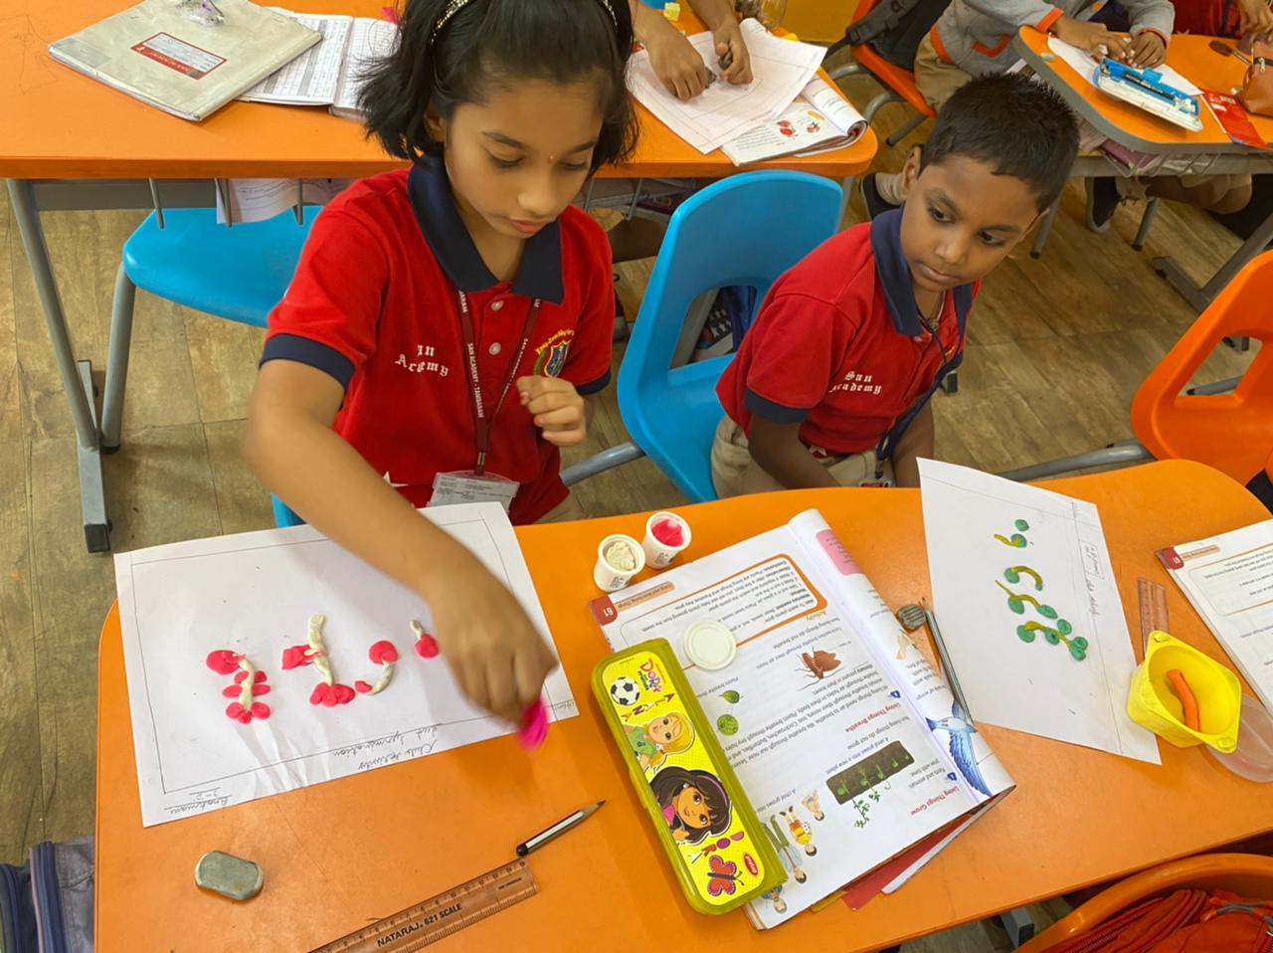



GRADE III TO V SCIENCE CLUB - 30.11.22

Slide 39



GRADE III TO V SCIENCE CLUB - 30.11.22

Slide 40

GRADE III TO V WORLD TELEVISION DAY
World Television Day discusses how globalisation and communication are portrayed in the modern world. It also explains how international relations and the development of major issues have been influenced by global communication, which also acts as a guiding principle for the global economy. Additionally, the day highlights how important and necessary communication is to cope with the modern world.
World Television Day emphasizes how communication has emerged as one of the most important global issues of the day, not only because of its importance to the global economy but also because it offers guidance for social and cultural developments. The day acknowledges the UN’s continuous efforts to address the major problems humanity faces, and how TV, as one of the most wide-reaching forms of communication today, should play a role in making the world aware of these issues.
World Television Day was celebrated on 28th November. Students participated in various activities and portrayed the cause and effects of Television. Snapshot of the day is shared below:

Slide 41


GRADE III TO V WORLD TELEVISION DAY

Slide 42

GRADE III TO V WORLD TELEVISION DAY

Slide 43

GRADE III TO V WORLD KINDNESS DAY
World Kindness Day is to highlight good deeds in the community focusing on the positive power and the common thread of kindness for good which binds us. Kindness is a fundamental part of the human condition which bridges the divides of race, religion, politics, gender and location. Approaches are being made to the United Nations by the peak global body, the World Kindness Movement, to have World Kindness Day officially recognized and its members unanimously sign a Declaration of Support for World Kindness. Glimpse of the World Kindness Day celebrated by the students of San Academy:

Slide 44

GRADE III TO V WORLD KINDNESS DAY

Slide 45

WELCOME TO GRADE VI TO IX

Slide 46


GRADE VI & VII ART AND CRAFT CLUB
Students are introduced to the concept of Art and craft club whichgives students a sense of achievement and allow them to takepride in their work which builds confidence. Paper Sculpture artis a great, safe way to discover that it's okay to make mistakesand that getting things 'wrong' can lead you to a whole new idea.The students are instructed step by step to do the sculpture after watching a tutorial video.

Slide 47



GRADE VIII AND IX THEATRE CLUB
A Theater club gives students an outlet for interests that go beyondacting and leads to friendships across grades.Students of grade IX conducted a lively puppet show .

Slide 48



GRADE VIII AND IX THEATRE CLUB

Slide 49






GRADE VIII AND IX THEATRE CLUB

Slide 50




GRADE VIII AND IX THEATRE CLUB

Slide 51

GRADE VIII AND IX THEATRE CLUB

Slide 52


SAY NO TO PLASTIC
Society has become completely dependent on plastic, yet we rarely stop and wonder how this material might be affecting our health. To create such awareness among children , the management of San Academy conducted the “Say No to Plastic” activity. Students were made to do an CSR acitivity using their used plastic products.

Slide 53




SAY NO TO PLASTIC

Slide 54




SAY NO TO PLASTIC

Slide 55





SAY NO TO PLASTIC

Slide 56

SAY NO TO PLASTIC

Slide 57


SAY NO TO PLASTIC

Slide 58

NO BAG DAY -FOOD WITHOUT COOKING-19.11.22
An Unique Cooking Without Fire activity was conducted on the NO Bag Day . Students creativity in preparation of different food items presentation techniques in health benefits of fresh vegetables were the key objective behind this activity.Students displayed great interest of love throughout te entire activity . Primary coordinators were called to judge the same. The event went on very we and all students encouraged to cultivate such healthy eating habits in their everyday life.

Slide 59






NO BAG DAY -FOOD WITHOUT COOKING-19.11.22

Slide 60


NO BAG DAY -FOOD WITHOUT COOKING-19.11.22

Slide 61


NO BAG DAY -FOOD WITHOUT COOKING-19.11.22

Slide 62




NO BAG DAY -FOOD WITHOUT COOKING-19.11.22

Slide 63

WORLD KINDNESS DAY 21.11.22
World Kindness Day is an international holiday that was formed in 1998, to promote kindness throughout the world and is observed annually on November 13 as part of the World Kindness Movement. It is observed in many. World Kindness Day presents us with the opportunity to reflect upon one of the most important and unifying human principles. On a day devoted to the positive potential of both large and small acts of kindness, try to promote and diffuse this crucial quality that brings people of every together.

Slide 64


WORLD KINDNESS DAY 21.11.22

Slide 65


WORLD KINDNESS DAY 21.11.22

Slide 66


WORLD KINDNESS DAY 21.11.22

Slide 67

THANK YOU

